Slide 1
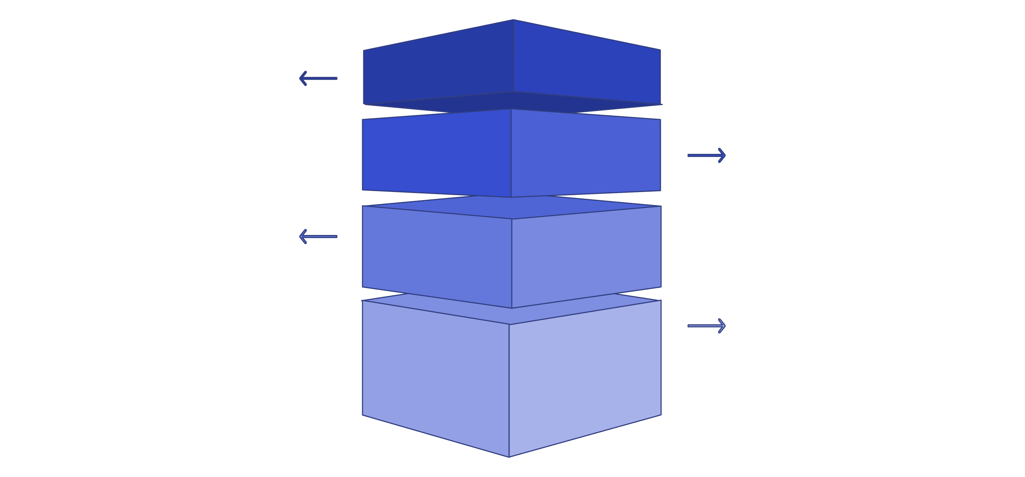
Overfitting vs. Underfitting
Overfitting and underfitting describe how well a machine learning model balances complexity and generalization. Overfitting happens when a model is too complex and learns the training data too closely, causing poor performance on new data. Underfitting occurs when a model is too simple to capture important patterns, leading to poor overall performance.
Foundation
Model is too simple; high bias.
Balanced Base
Right complexity; good generalization.
Complex Layer
Model fits training details closely.
Overfitting Apex
List of Presenters
👤 Blessing Edet
👤 Nyima
👤 Tsogtbileg Erdenebaatar (T.S)
Poor performance on new data.
Notes:
Overfitting and underfitting are two key concepts in machine learning that describe the relationship between model complexity and generalization. Overfitting occurs when a model is too complex and fits the training data too closely, failing to generalize well to new, unseen data. Underfitting is the opposite - when a model is too simple and cannot capture the underlying patterns in the data, leading to poor performance on both the training and test sets. Finding the right balance between model complexity and generalization is crucial for building reliable machine learning systems that perform well in real-world production environments. We'll explore these concepts in more depth and discuss strategies for identifying and addressing overfitting and underfitting in our models.

Slide 2
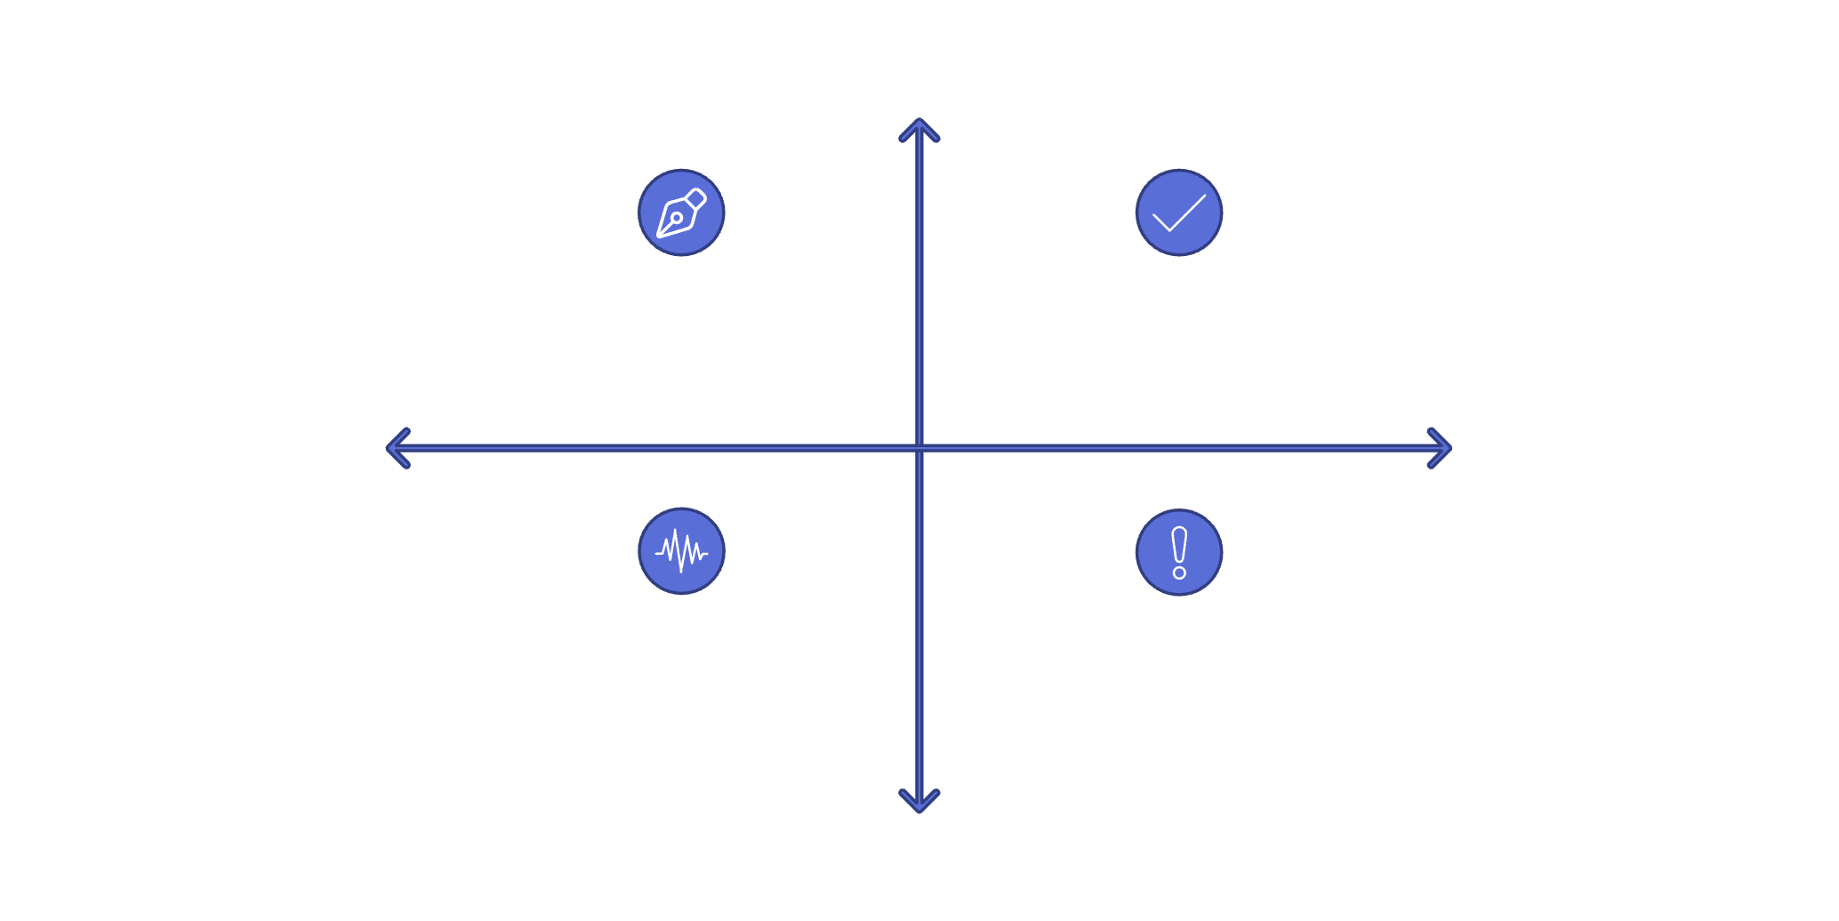
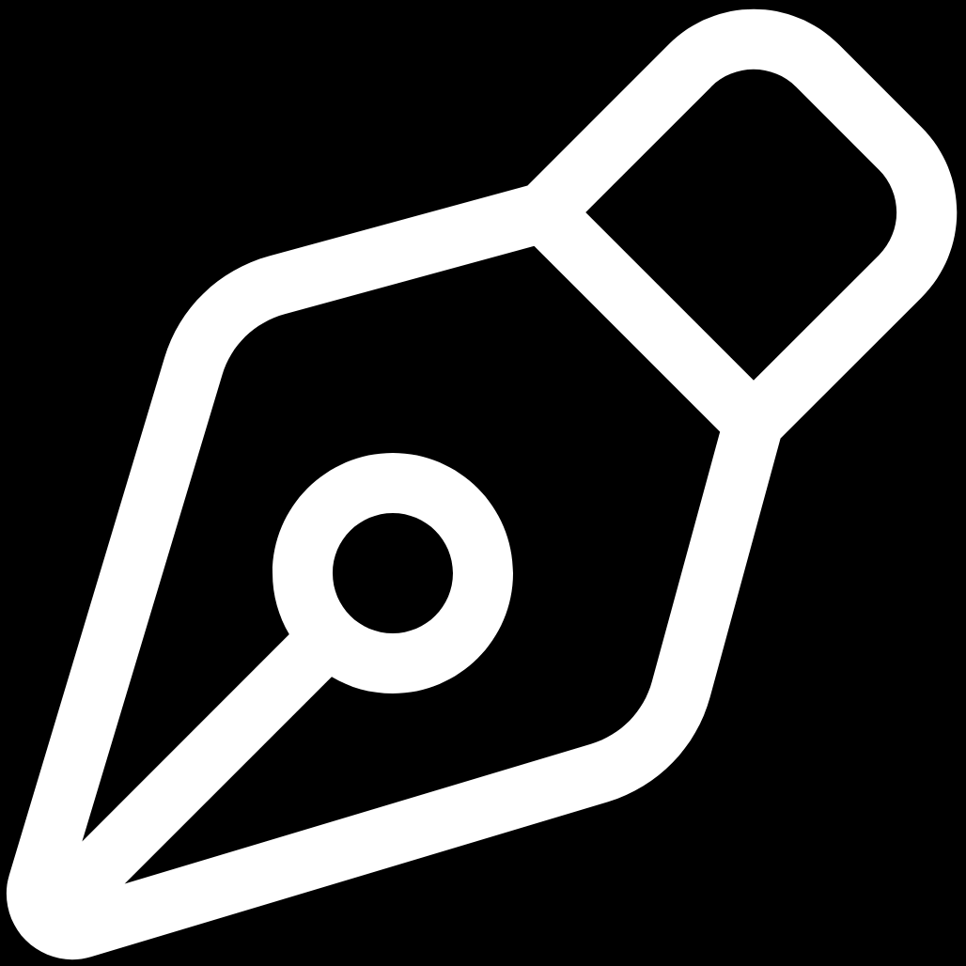
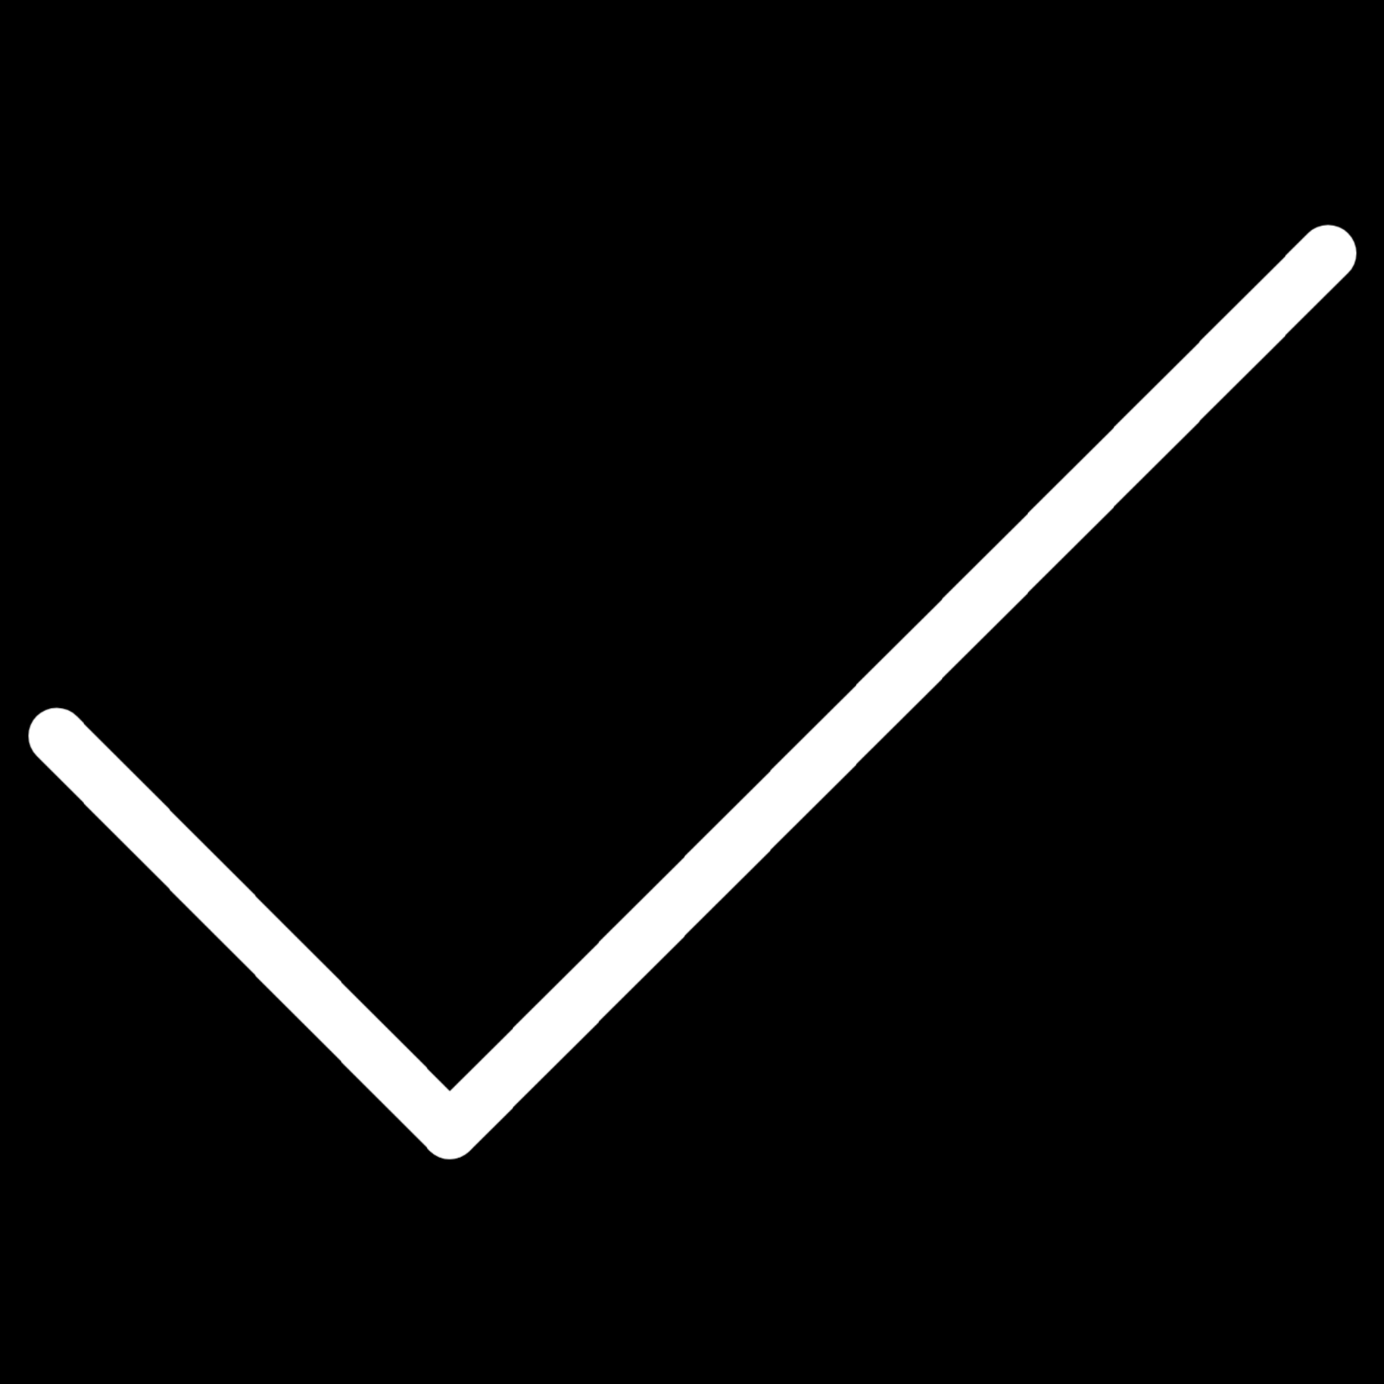
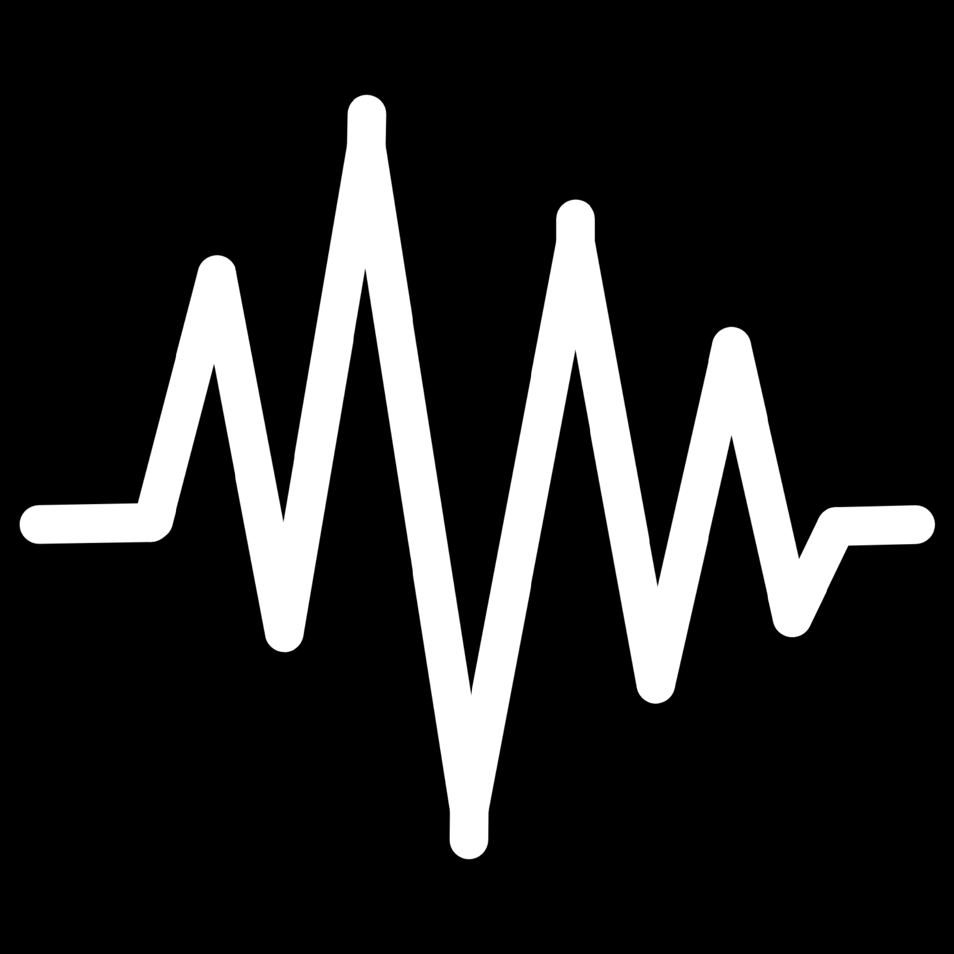
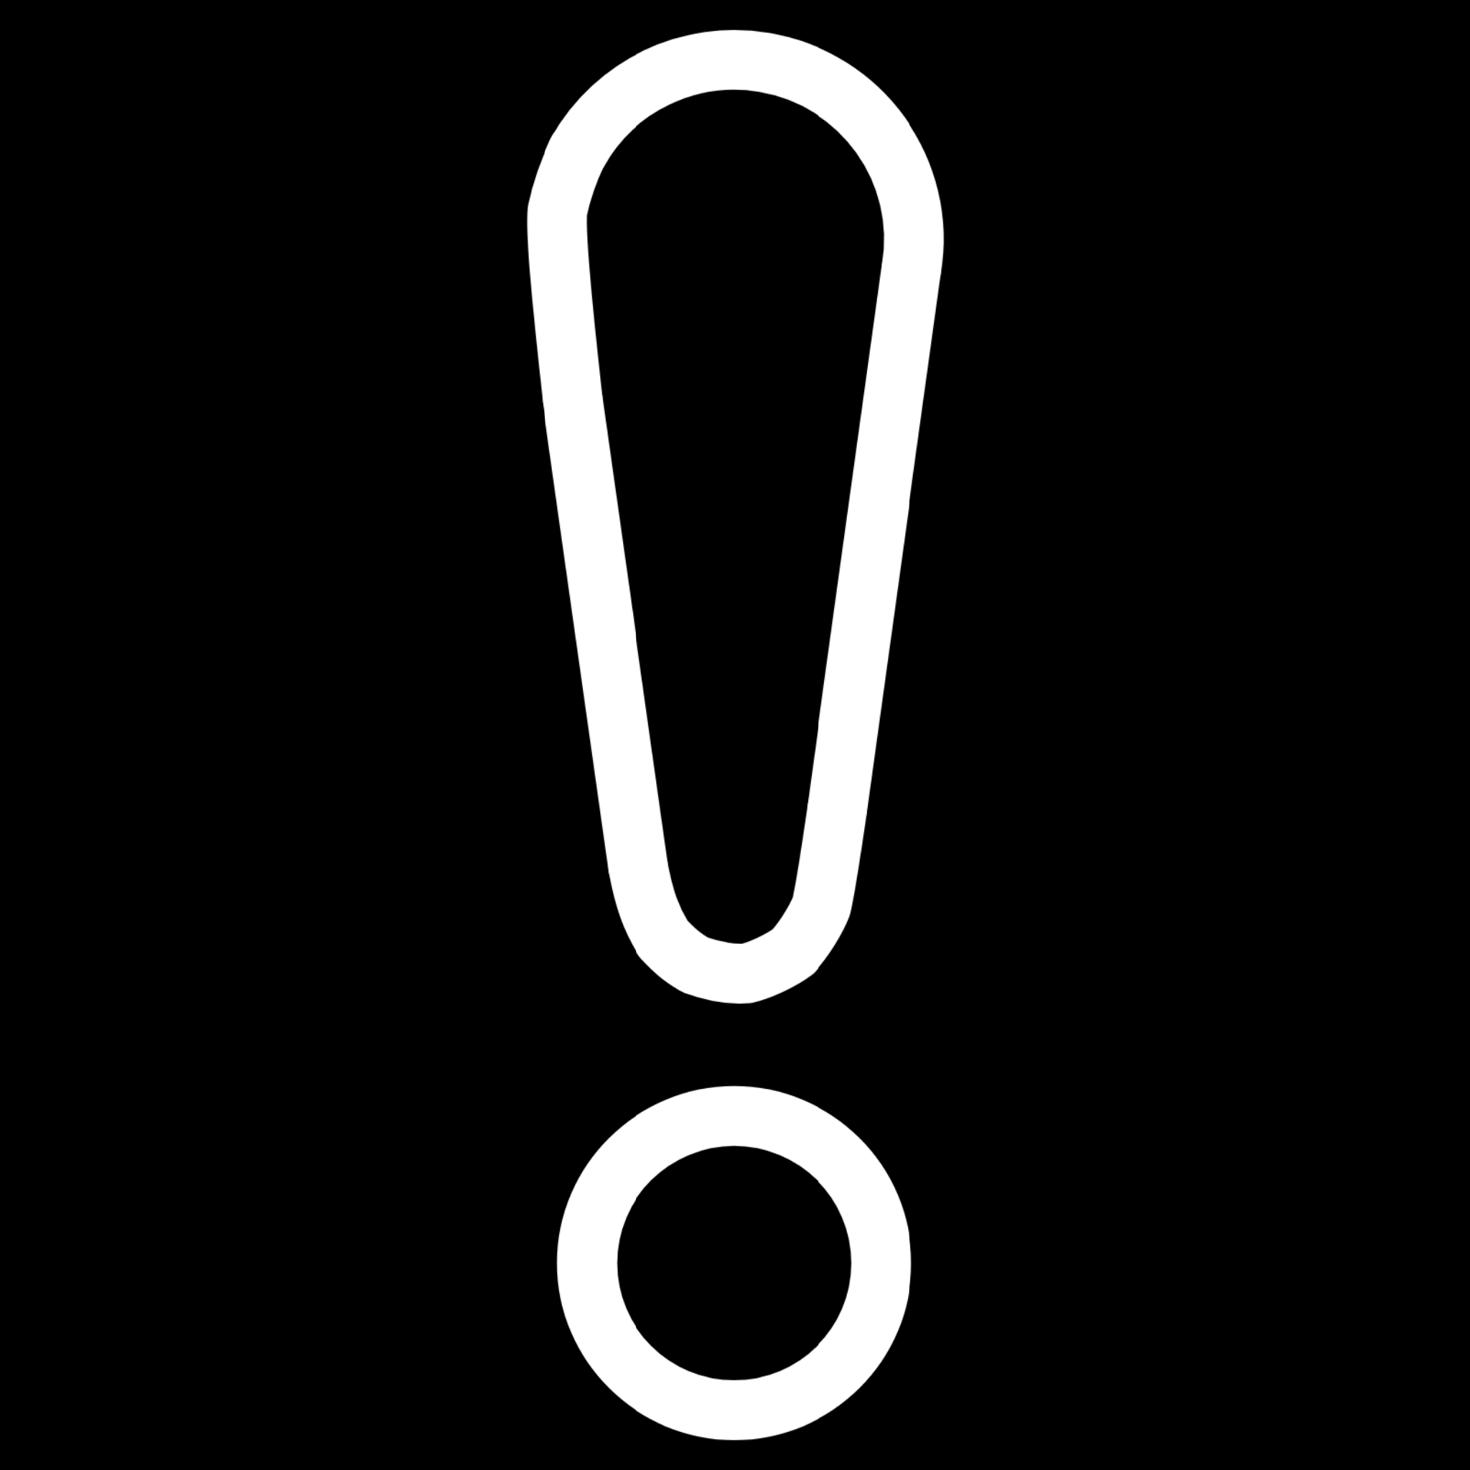
The Challenges of Model Fittiness
Underfitting: Too Simple
High Bias
When a model is too simple, it fails to capture the underlying patterns in your data. Like trying to fit a straight line through clearly curved data, an underfit model misses critical relationships and performs poorly on both training and test data.
Underfitting - Straight line misses curve
Good Fit - Smooth curve captures pattern
High Variance
Low Bias
Overfitting: Too Complex
Overfitting - Zigzag follows noise
Validation Failure - Poor generalization
An overfit model memorizes training data, including noise and outliers, rather than learning generalizable patterns. It achieves perfect training accuracy but fails when encountering new data.
Low Variance

Slide 3

Why Overfitting Hurts Real-World Performance
Overfitting creates a dangerous illusion of success. Your model appears to work perfectly during development, achieving near-perfect accuracy on training data. But this performance masks a critical flaw: the model has simply memorized specific examples rather than learning the underlying logic.
When deployed in production, an overfit model encounters data it's never seen before. Without true understanding of the patterns, it makes unreliable predictions that can have serious consequences for your business and users.

Slide 4
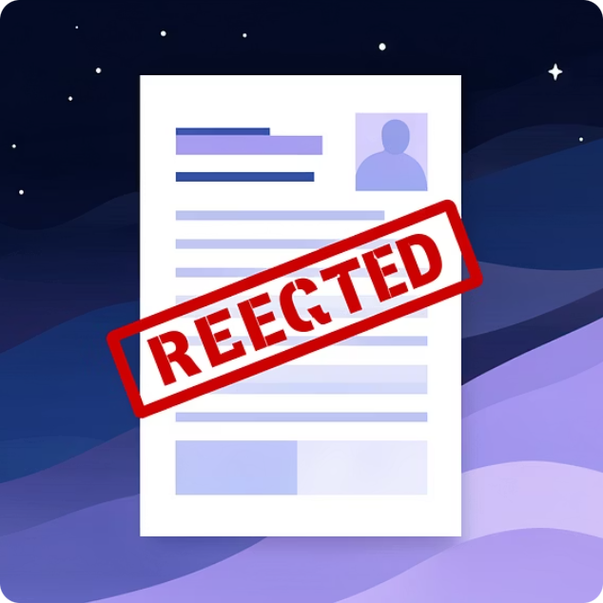

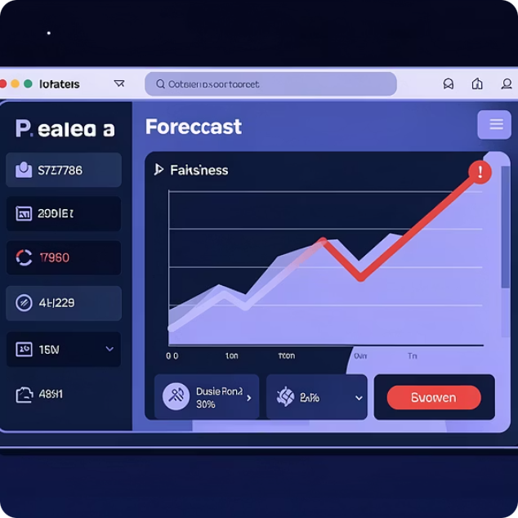
Real-World Impact of Overfitting
Financial Services
Healthcare Diagnosis
Business Forecasting
Loan approval systems that overfit historical data may reject creditworthy applicants whose profiles don't match past patterns, missing qualified customers and potential revenue.
Overfit medical models can provide incorrect diagnoses when patient presentations vary slightly from training examples, potentially putting patient safety at risk.
Sales and demand forecasts that memorize historical conditions fail spectacularly when entering new markets or facing changed economic conditions.

Slide 5
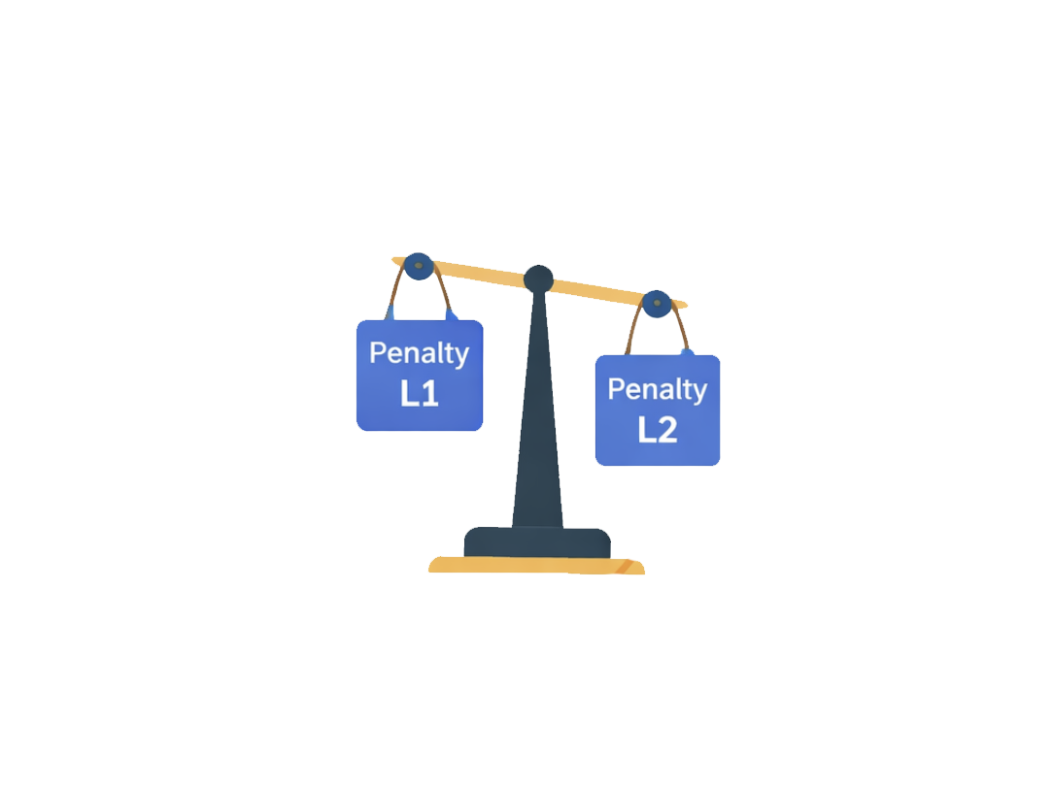
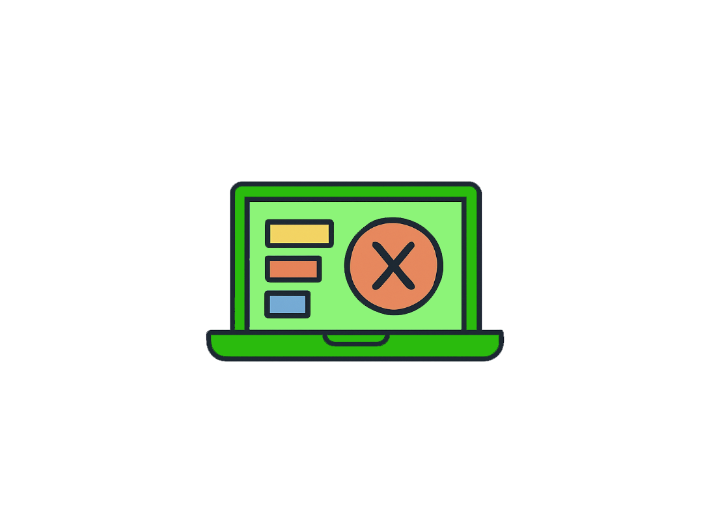
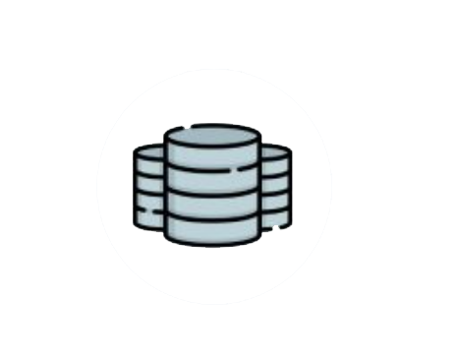
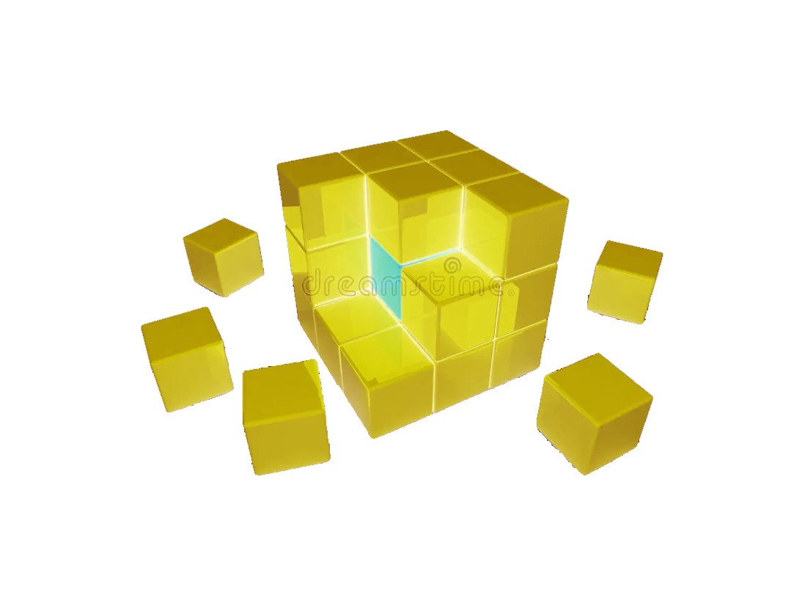
Strategies to Prevent Overfitting/Underfitting
Cross-Validation
Regularization
Early Stopping
More Training Data
Tests a model on smaller chunks of data to ensure it performs well on unseen data.
Used to stop an AI model from becoming too complex and overfitting the data.
Prevents overfitting by stopping training before it becomes too much of a memorization.
Increase dataset size to make it harder for the model to memorize noise.
Ensemble Methods
Pruning
Combine multiple models to reduce overfitting risk, as errors in individual models tend to cancel out when aggregated.
Remove irrelevant or redundant features that contribute noise, helping the model focus on truly predictive signals.

